Slide 1
Social Media Analytics Nike and Adidas

Slide 2
Mining Tweets using twitteR library
Authenticate Twitter Account
setup_twitter_oauth(consumerKey, consumerSecret, accessToken, accessSecret)
Search adidas and nike on twitter
adidas.list <- searchTwitter("#adidas", n=500)
nike.list <- searchTwitter("#nike", n=500)

Slide 3
Function to score words using opinion lexicon by Hu and Liu

Slide 4
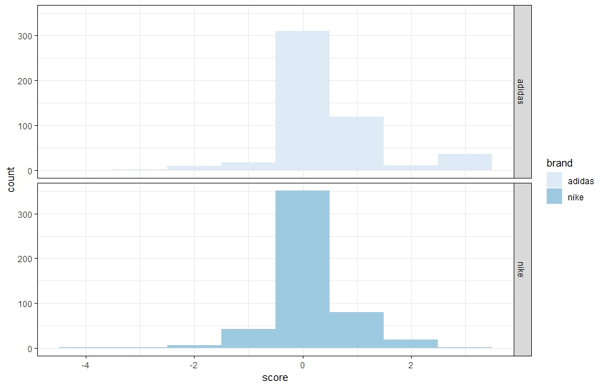
Histogram of sentiment – Adidas VS Nike

Slide 5
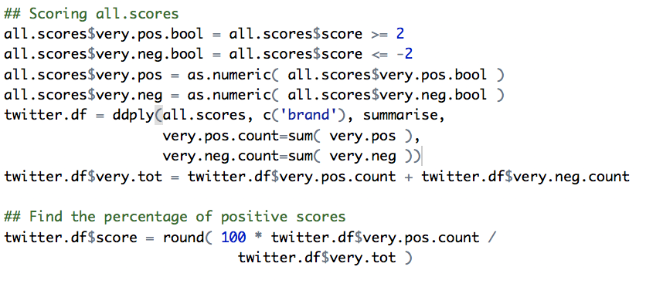
To get a single twitter score for comparison with asci score
Use only the extreme tweets (highly positive and highly negative)
Highly positive are those with scores >=2 and highly negative are those with scores <=2
Get the overall score
Highly positive score / highly positive score + highly negative score

Slide 6
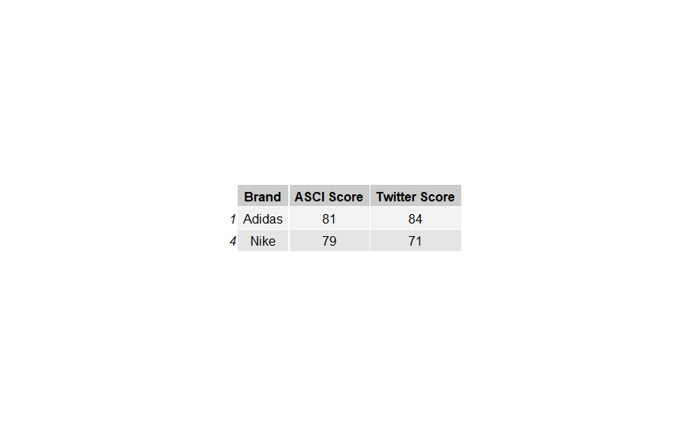
Comparing ASCI score with twitter sentiment score

Slide 7
Analysis of Nike VS Adidas
Adidas has a higher percentage of highly positive tweets compared to Nike.
Nike has a score of 71 compared to Adidas which has a score of 84.
This supports that Nike having a lower ACSI score compared to Adidas.
Nike has a ACSI score of 79 while Adidas has a ACSI score of 81.
Insights
Tweets were crawled during World Cup 2018. While Nike offers a mpre appealing range of athletic wear, Adidas exceeds Nike in football jerseys and athletic shoes.
Minimal differences between Twitter and ACSI scores.
Our analysis is based on a sample of 500 tweets while ACSI analysis is based on a bigger population size.

Slide 8
Limitations in Sentiment Analysis
Minimal differences between Twitter and ACSI scores.
Our analysis is based on a sample of 500 tweets while ACSI analysis is based on a bigger population size.
Did not use language filters.
As a result, a few tweets were left out .
No analysis of emoticons

